Slide 1
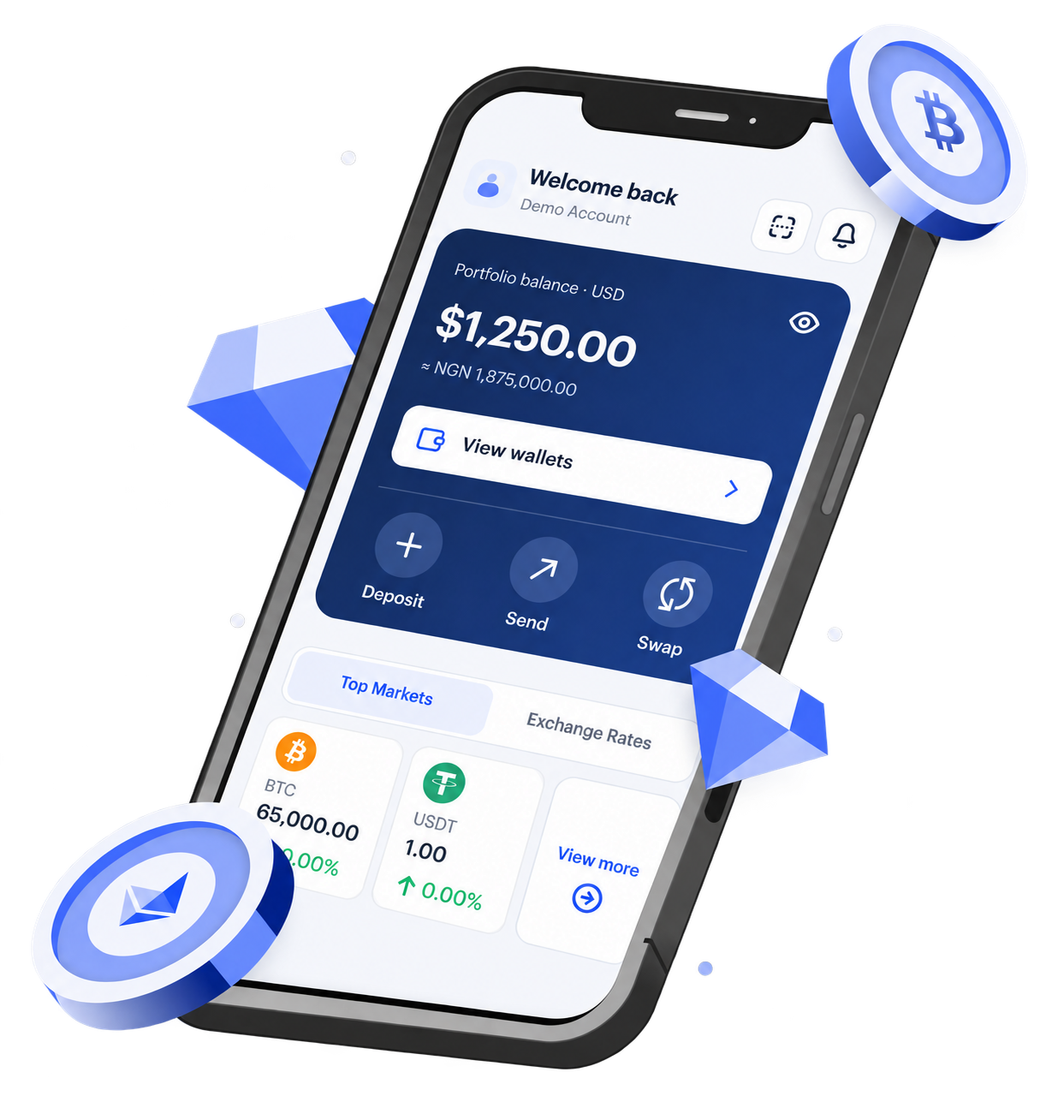

Ad · Paid partnership with BoundlessPay
Send, spend and save across borders.
“I’m a BoundlessPay ambassador. Learn more through my partner link.”
[your-tagged-link]
YOUR LOGO
BoundlessPay is a financial technology company, not a bank. Services via licensed partners; availability varies by jurisdiction.

Slide 2

IN PARTNERSHIP WITH BOUNDLESSPAY
YOUR LOGO
[Headline about your partnership — e.g. “Faster payouts for our community.”]
[One sentence on what is available today, where.]
[your-tagged-link]
BoundlessPay is a financial technology company, not a bank. Services via licensed partners; availability varies by jurisdiction.

Slide 3
Ad · Paid partnership with BoundlessPay
[Service name]
[Short, factual benefit headline.]
[Verified fact 1]
[Verified fact 2]
[Verified fact 3]
YOUR LOGO
BoundlessPay is a financial technology company, not a bank. Services via licensed partners; availability varies by jurisdiction.

