Slide 1

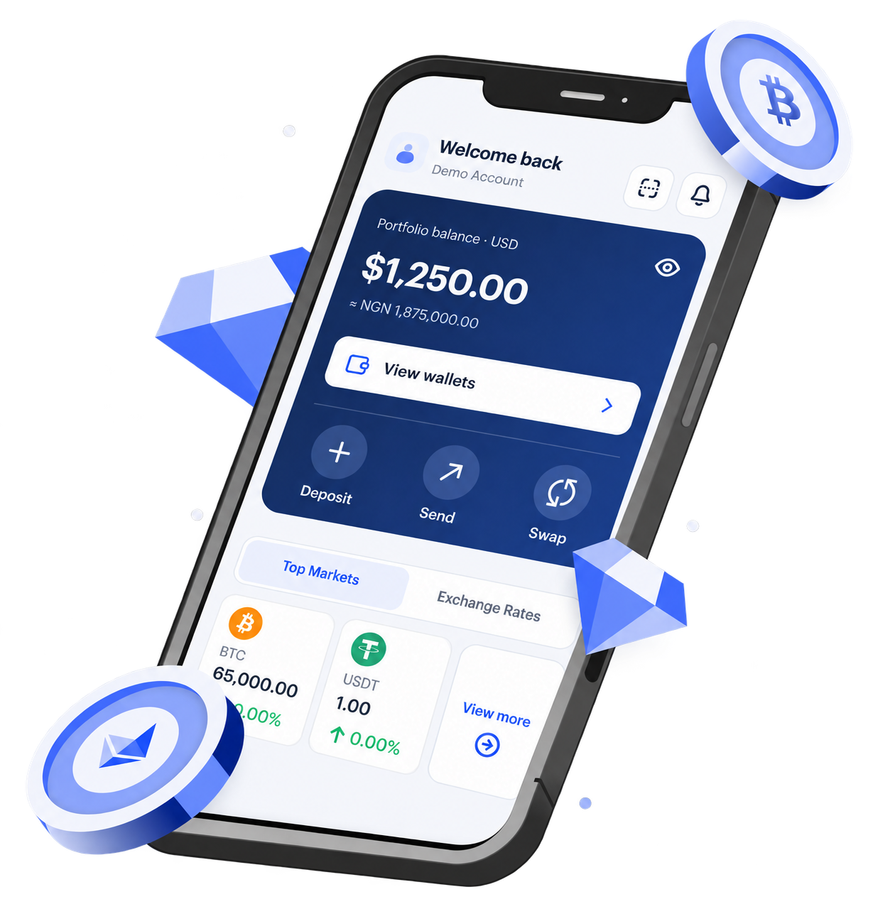
YOUR LOGO
[Presentation title]
[Presenter name · Partner organisation · Date]
In partnership with BoundlessPay · Subject to BoundlessPay approval

Slide 2

YOUR LOGO
[Section title]
[Key point one]
[Key point two]
[Key point three]
[Image or chart]
In partnership with BoundlessPay · Subject to BoundlessPay approval

Slide 3
YOUR LOGO
What BoundlessPay offers
Personal
Business
Explore BoundlessPay for personal payments.
BoundlessPay Business Suite for your business.
app.boundlesspay.com
business.boundlesspay.com/register
In partnership with BoundlessPay · Subject to BoundlessPay approval

Slide 4
YOUR LOGO
[Big statement or verified figure]
[Source / date]
In partnership with BoundlessPay · Subject to BoundlessPay approval

Slide 5
YOUR LOGO
Thank you
[Your contact] · [your-tagged-link]
©Boundless Nexus Limited operating as BoundlessPay® is a financial technology company, not a bank. Virtual accounts, payment cards, custody, and on/off-ramp services are delivered through licensed partners. Service availability may differ by jurisdiction and remains subject to regulatory approval. Our platform enables banking-like experiences powered by stablecoins.

